Slide 1
Decarbonization of airlines from the Wright Brothers to Sustainable Aviation Fuel
Matthew Kurniawan

Slide 2
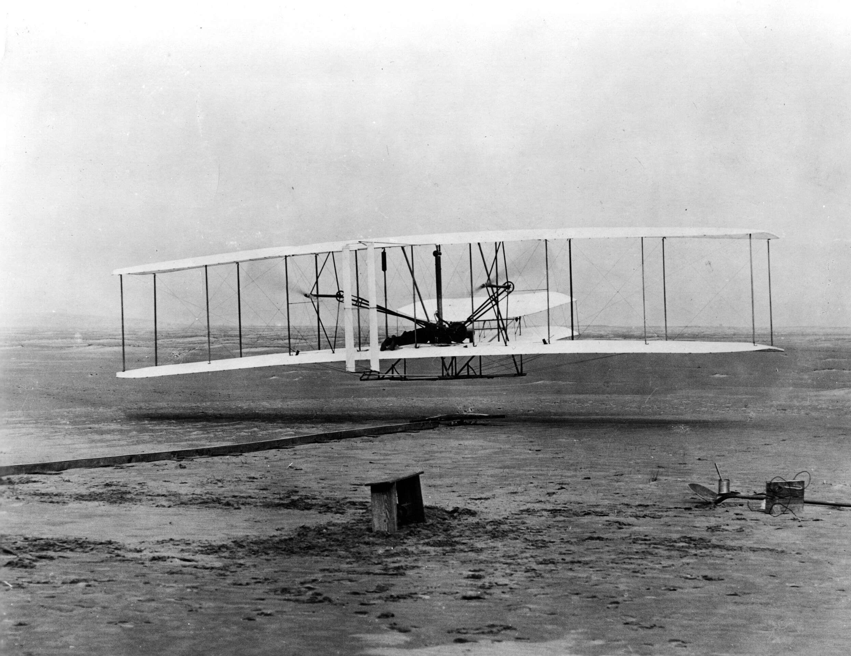
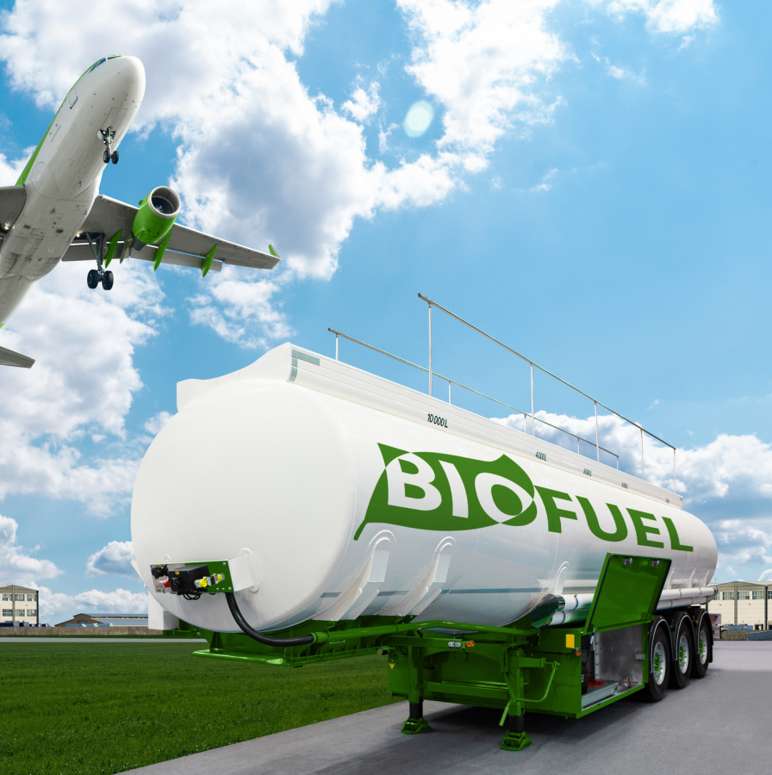
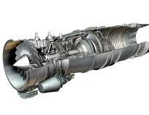
Introduction
From the Wright Brothers First Flight to the modern era of sustainable aviation fuel, aviation is returning to its roots to solve a climate crisis.
Singapore leads the transition to Sustainable Aviation Fuel by announcing a fuel levy from October 1, 2026.
SAF derives from renewable waste oils and agricultural residue, offering up to 80% reduction in carbon cycle emissions.
Notes:
From the Wright Brothers’s first flight in 1903 to the modern era of Sustainable Aviation Fuel
(SAF), aviation is returning to its roots of innovation to solve the climate crisis. The revolutionary
SAF fuel derives from renewable waste oils and agricultural residue, offering up to 80% lower
carbon cycle emissions. This transition aims to make aviation as sustainable as it was during its
low-emission days, while powering the future of air travel. Leading this transition is Singapore,
which announced the world’s first mandatory sustainable aviation fuel levy starting from
October 1, 2026. This landmark move marks a unique, consumer-focused approach to financing
the future of flight. This shift highlights a major evolution to cleaner, alternative energy for air
travel. While early pioneers focused on the feasibility of flight, modern aviation is focused on
the sustainability of it. The shift from the Wright Brothers’ initial gasoline to sustainable aviation
fuels of today represents a crucial evolution in environmental stewardship and decarbonization
of the airline industry

Slide 3
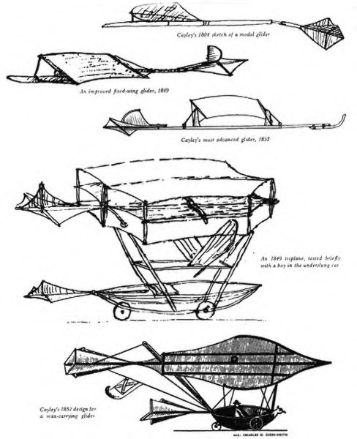
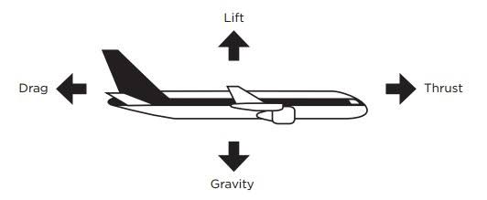
Fundamentals of Aviation
Sir George Cayley established the fundamental principles of aerodynamics (lift, thrust, and drag) and flew the first successful manned glider in 1853.
Lilienthal made over 2000 controlled glides between 1891 and 1896.
Notes:
The father of aviation, Sir George Cayley (1804-1853) established the fundamental principles of
aerodynamics (lift, drag, and thrust) and flew the first successful manned glider in 1853.
Significant advances in glider technology were made, with Otto Lilienthal and Sir George Cayley
being key pioneers. Lilienthal made over 2000 controlled glides between 1891 and 1896. These
innovators focused on developing stable, controllable, heavier than air aircraf

Slide 4
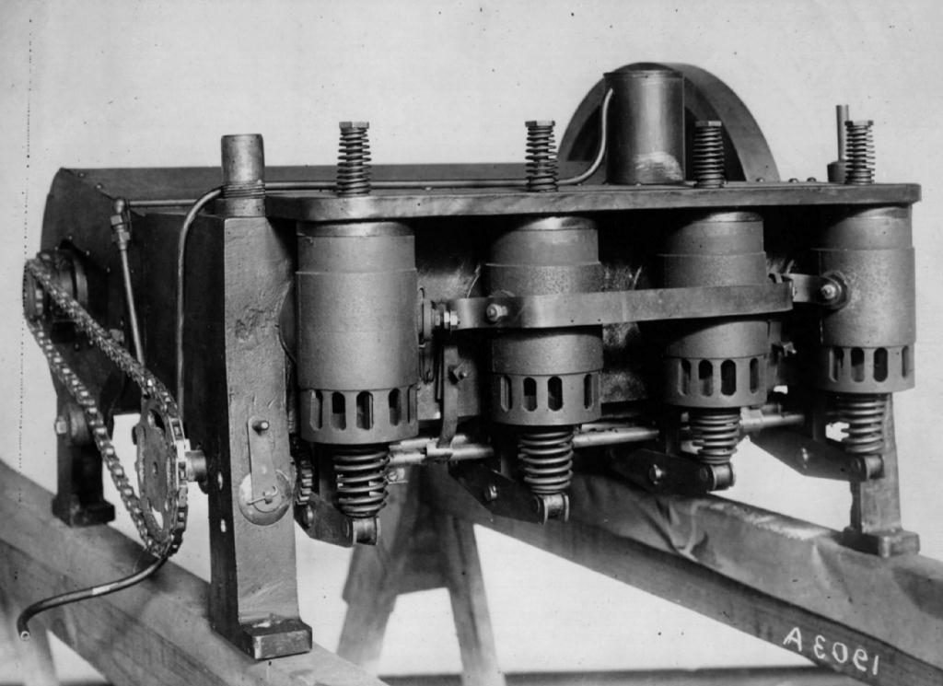
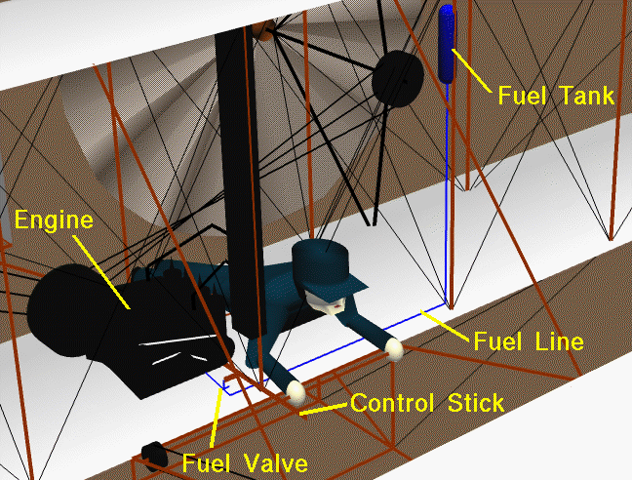
Wright Brothers’ First Flight
The Wright Brothers’ first airplane, the 1903 Wright Flyer, was flown over Kitty Hawk, North Carolina. This historic flight lasted 12 seconds.
Featured 12 horsepower engine and used low octane gasoline.
Charles Taylor was the engine builder
Wright Brothers completed four flights that day, longest being 59 seconds and covering 852 feet.
Notes:
The first ever airplane, the 1903 Wright Flyer, flown by Wilbur and Orville Wright (The Wirght
Brothers) was flown over Kitty Hawk, North Carolina. The historic flight lasted twelve seconds
with Orville Weight at the controls. This was the first successful powered, controlled, heavier
than air airplane. This airplane featured a 12-horsepower engine and used a low octane
gasoline which was gravity fed from a tank on a wing strut to a custom built four-cylinder
engine. The fuel had a low octane rating, likely between 30 and 40. The early, primitive fuel air
mixing systems (carburetors) and lack of cooling meant that these systems operated on the
edge of failure. The Wright Brothers shop mechanic, Charlie Taylor, was the engine builder. The
Wright brothers completed four flights that day, with the longest lasting 59 seconds and
covering 852 feet.

Slide 5
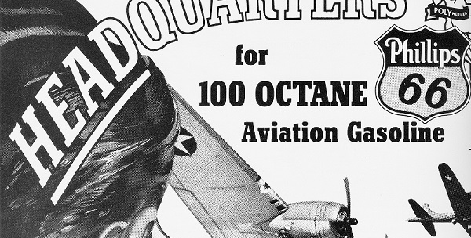
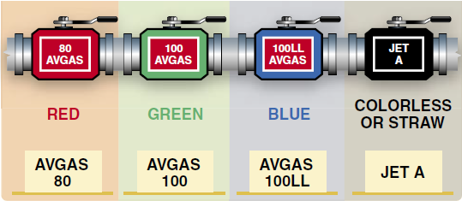
Early Aviation Gas
Early aviation gas used was a 65 octane fuel as aircraft engines became more powerful, needing higher compression ratios to improve performance and fuel efficiency.
TetraEthyl Lead (1920s) improved octane rating, allowing high-powered piston engines
Notes:
As aircraft engines became more powerful, the need for higher compression ratios became
critical to improving performance and fuel efficiency. The early aviation gas (Avgas) used was a
65-octane fuel. As engines became more powerful, knocking became a limiting factor. To
combat this, the industry introduced Tetraethyl Lead (TEL) in the 1920s to improve octane
rating, which enabled the use of high-performance piston engines required for World War II
fighter planes, such as the Rolls Royce Merlin engine.

Slide 6
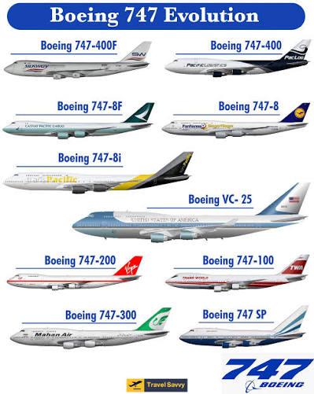
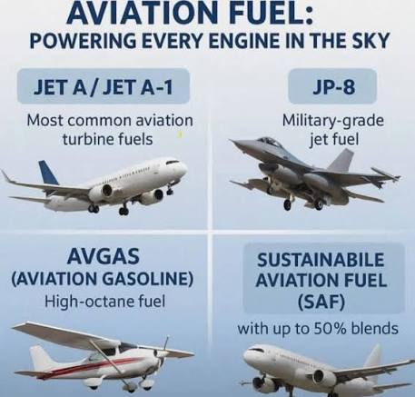
Shift to Gas Powered Turbine Engines
Notes:
Airline fuels have evolved from early gasoline to specialized kerosene-based jet fuels (Jet A/A1)
in the 1950s which was because of the shift to gas powered turbine engines which required a
fuel with a higher flash point. Jet engines do not require high octane to precent pre-ignition. However, they require fuel with a high energy density and a lower freezing point. The jet engine
allowed for the development of larger, more durable aircraft. The 1970s brought in wide-body
aircraft (Boeing 747) which prioritized fuel efficiency, leading to the development of high-bypass
turbofan engines.

Slide 7
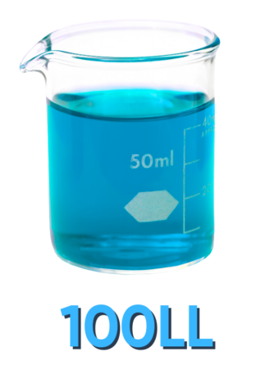
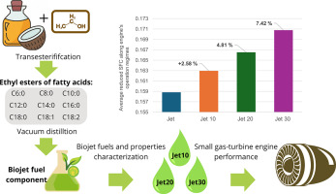
Ban on Leaded Fuel and Testing of Alternative Fueld
Notes:
Following the EPA’s ban on leaded fuel in the 1970s and 80s, aviation struggled to drop leaded
fuel from piston engines, resulting in the adoption of 100LL (low lead). Testing began on
alternative fuels in 2008. In that year, Virgin Atlantic conducted the first test flight using a mix of
biofuel (derived from babassu oil and coconut oil) and conventional fuel in one jet engine.
Sustainable Aviation Fuel (SAF) is currently derived from renewable feedstocks, including
cooking oil, animal fats, and municipal waste. It is chemically similar to conventional jet fuel and
can be used without modifying engines.

Slide 8
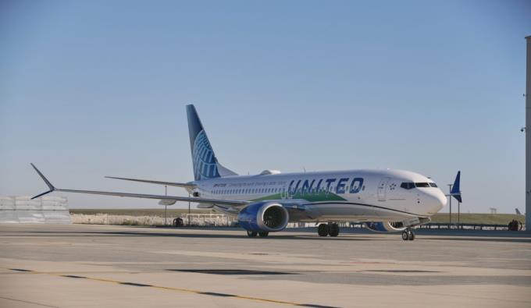
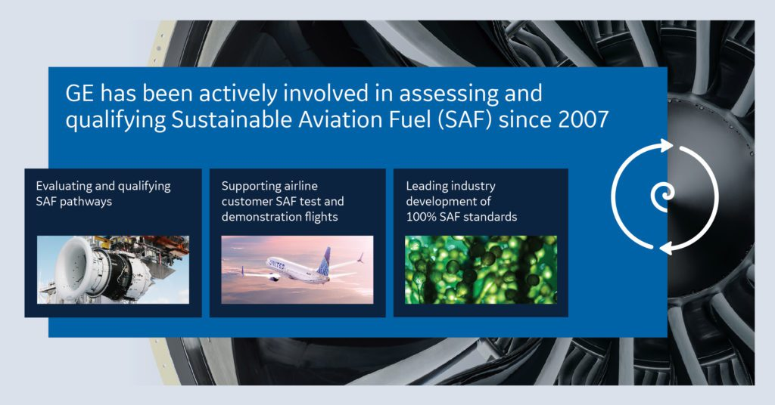
General Electric’s Sustainable Aviation Fuel Testing
Notes:
In March 2016 United Airlines became the first airline
to use sustainable aviation fuel for routine operations at Los Angeles. World Energy (formerly
AltAir Fuels) supplies the fuel to the Los Angeles hub.
General Electric Aerospace reports that on December 1, 2021, United Airlines operated the first
passenger flight using 100% sustainable aviation fuel in one of two aircraft engines on a flight
from Chicago to Washington, D.C. on a Boeing 737 Max 8 with 115 passengers on board. At that
time, international standards following the process developed by ASTM international permitted
airlines to use a maximum of 50% SAF on commercial flights. On that flight, United Airlines
operated one of the planes’ engines on 100% SAF fuel and the other on conventional jet fuel,
which was about 500 gallons per engine. The SAF is interchangeable with conventional Jet A and
A1 fuel and requires no modifications to engines or airframes. GE Aviation’s SAF testing included
several industry-first test flights: the first commercial SAF demonstration test flight (2008), the
first SAF transatlantic flight of a large freight commercial airplane (2011), the first 100% SAF
military jet flight (2016) and the first use of power-to-liquid (PtL) earlier in 2021, in which renewable energy is used to split water in hydrogen and oxygen, then the resulting H2 is used
with captured CO2 to synthesize liquid hydrocarbon fuel.

Slide 9
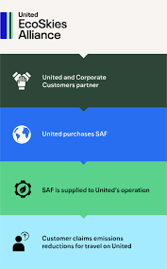
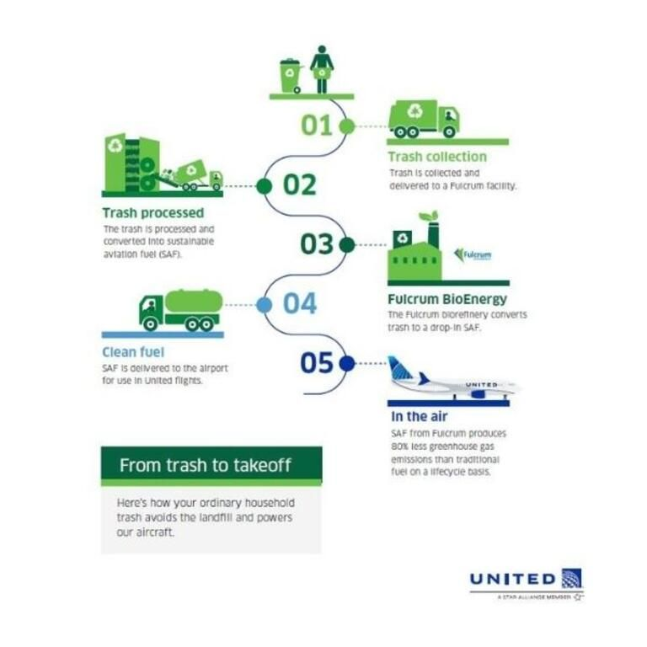

United Airlines commitment to Sustainable Aviation Fuel
Notes:
United has made the largest commitment of any airline in the world towards the transition to
Sustainable Aviation Fuel. In Spring 2021, United launched the Eco-Skies Alliance program in
which a list of 29 corporate partners and counting have collectively contributed towards the
purchase of approximately 5.7 million gallons of SAF in 2021. This eliminates approximately
53,000 metric tons of GHG emissions, or enough to fly passengers over 372 million miles.

Slide 10
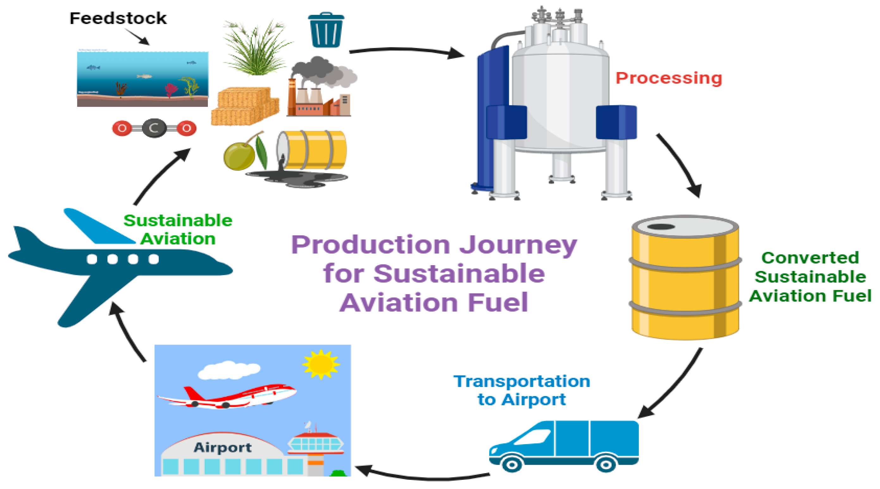
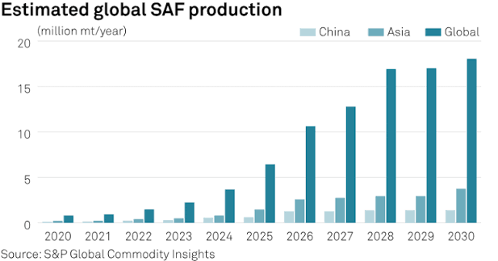
Sustainable Aviation Fuel Production
Notes:
SAF production is growing with US production doubling between December 2024 and February
2025. SAF can reduce lifecycle CO2 emissions by up to 80%. SAF produces fewer chemical
pollutants and, due to lower aromatic content, reduces contrail formation, a major contributor
to radiative forcing (atmospheric warming). The aviation industry faces increasing pressure as
air traffic grows. Current efforts focus on scaling up, with 100% renewable fuel on the horizon,
alongside research into hydrogen and electric propulsion. Large-scale implementation could
contribute to 64% total emissions savings by 2050. The challenges of implementing sustainable
aviation fuel include the lack of production capacity as current production only meets 1% of the
global jet fuel demand. High production costs (USD 2500 per metric tonne (1000kg) for SAV vs
USD 734 for conventional fuel) limit voluntary uptake by airlines. A technology limitation of SAF
is that it requires requires significant energy to produce, which may affect scalability

Slide 11
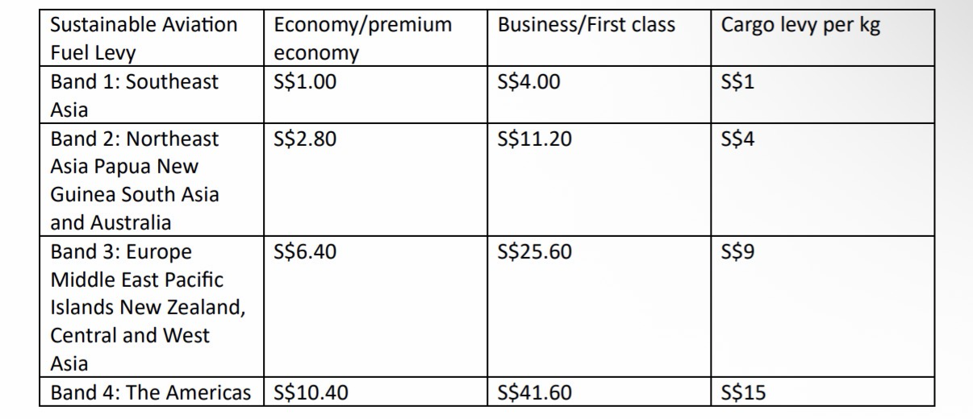
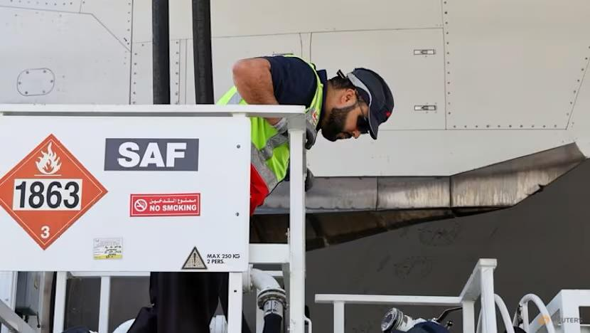
Government Initiatives in SAF fuel
Notes:
To scale SAF, governments are implementing policies to incentivize production and mandate
usage, bridging the price gap. One such policy is the implementation of the world’s first ever
sustainable aviation fuel levy for flights that are departing from Singapore Changi Airport from
October 1, 2026 and for tickets sold from April 1, 2026, with a surcharge from S$1 to S$41.60
per ticket depending on travel destination and airline class in four bands. This is to fund the
procurement of SAF, aiming for a 1% SAF blend at Changi and Seletar Airports in 2026,
increasing to 3-5% in 2030. At that point, levy adjustments will be made then. This fee applies to all departing passengers but excludes those in transit. The airline must collect the levy and
display it as a separate line item on air tickets sold and air cargo contracts. Training flights and
those for charitable or humanitarian purposes are exempt from the levy. Funds will be managed
by a central agency, SAF co. to aggregate demand and secure fuel, which is currently 3-5 times
more expensive than conventional fuel. This initiative aligns with Singapore’s commitment to
net-zero carbon emissions by 2050 (Guang-Xi 2025).

Slide 12
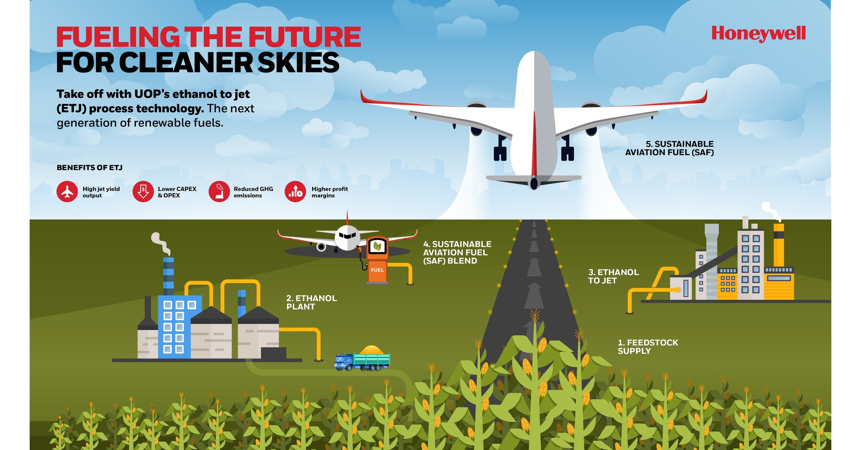
Conclusion
The progression from the Wright Brothers’s innovation to the use of Sustainable Aviation Fuel and Singapore’s world first sustainable aviation fuel levy proves that the future of flight requires blending the pioneering spirit of early aviation with the modern environmental science.
Notes:
The progression from the Wright Brothers’s innovation to the use of Sustainable Aviation Fuel
and Singapore’s world first sustainable aviation fuel levy proves that the future of flight requires
blending the pioneering spirit of early aviation with the modern environmental science. While
SAF is a technology that can be used in conventional jet engines, its success depends heavily on
such policy-driven funding to ensure scalability. As Singapore acts as a catalyst on this, the
transition to cleaner, more sustainable aviation represents the move from concept to reality
while bridging the gap between historical achievement and environmental necessity

